Slide 1
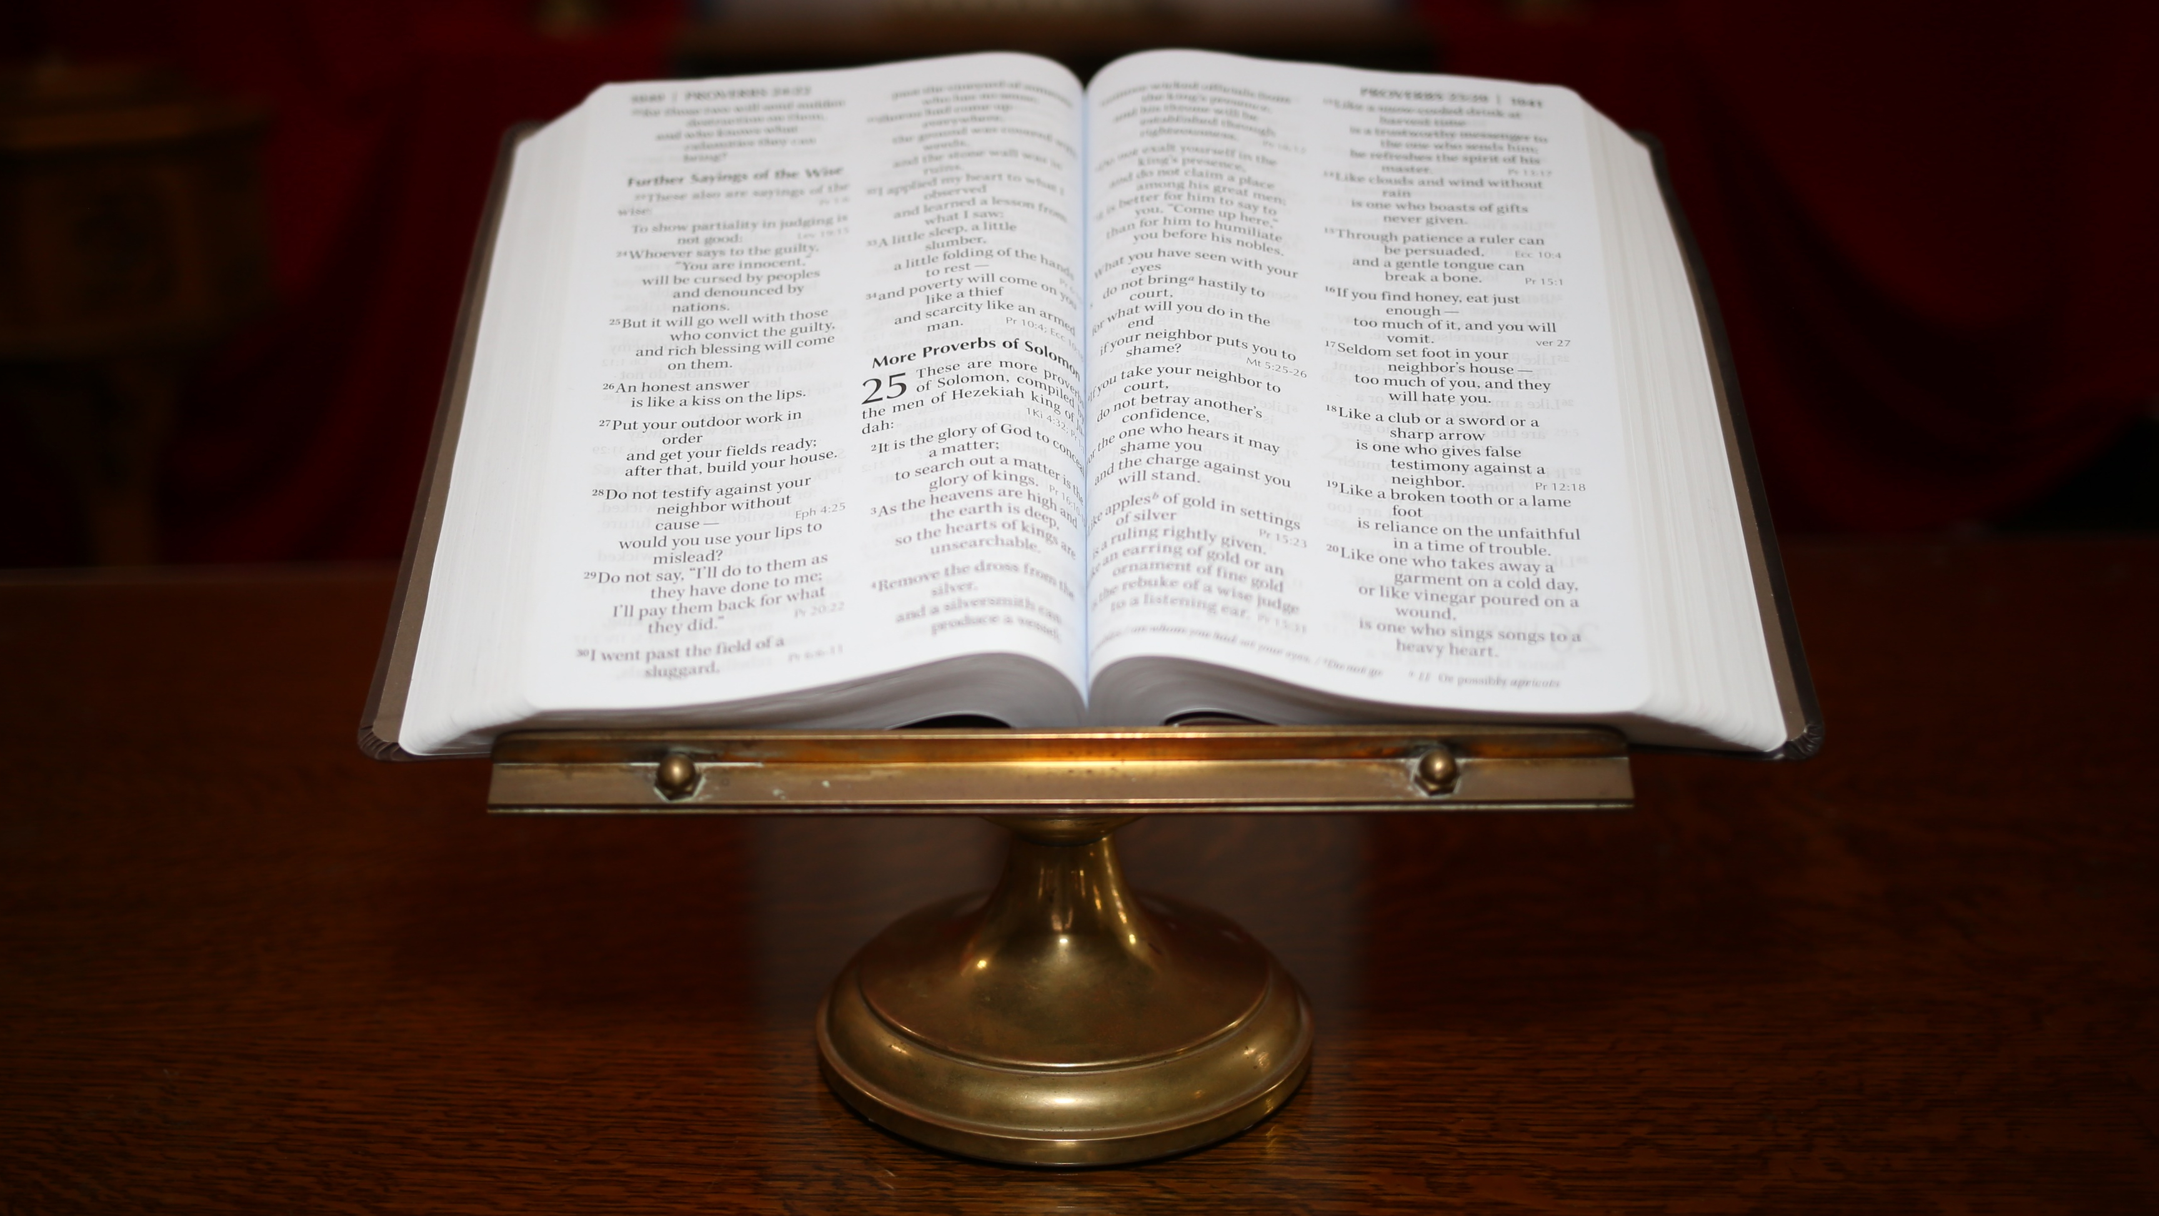
Sunday April 7, 2024
2nd of Easter

